Slide 1
Group 3
Hotel Management System
Members
Anurag Hale 03
Shubham Khose 44
Nikunj Mistry 64
Mentor
Dr. Madhuri Rao

Slide 2
ABOUT THE TOPIC
The project, Hotel Management System is a application that allows the hotel manager to handle all hotel activities.
Interactive GUI and the ability to manage various hotel bookings and rooms make this system very flexible and convenient.
Hotel management project provides room booking, staff management and other necessary hotel management features. The system allows the manager to post available rooms in the system.

Slide 3
Problem Statement & objective
A hotel system manages various information about rooms, reservation, customers, building etc.
This customer can make a reservation through hotel website. He requires details as in, availability of rooms, dates, customer details-If everything seems fine he receives a confirmation number from the website.
The desk clerk checks in the time and billing record is created at that time. Customer billing is recorded is updated every night at 12.
Customer can pay by cash when they check out If the customer needs a pick up/down service, online availability can also be made.
One has an access to the details of the driver the nature of vehicle, his current location. And the type of car used by driver.

Slide 4
The app bears many more function.
• Room status
• Allocated Room Modification
• Check In/Check Out details
• Customer details
• Total customer present in hotel
• Services like rides, also included
• Billing
• Hotel staff and their details
• Miscellaneous services.
There are new Strategies technologies emerging every day that one needs to track on. How effective one manages their property, pays to have your finger on the pulse. Its thereby essential to have the most effective system incorporating multiple areas with all its ardently meticulously and its caliber.

Slide 5
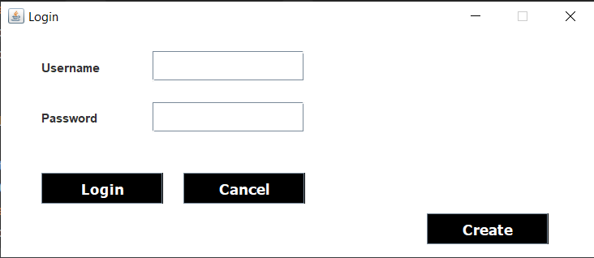
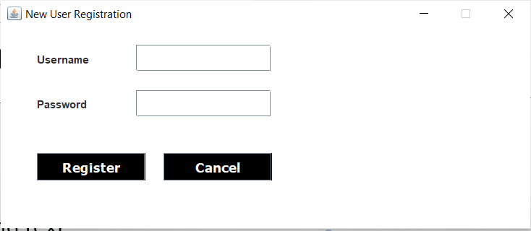
Framework Progress

Slide 6
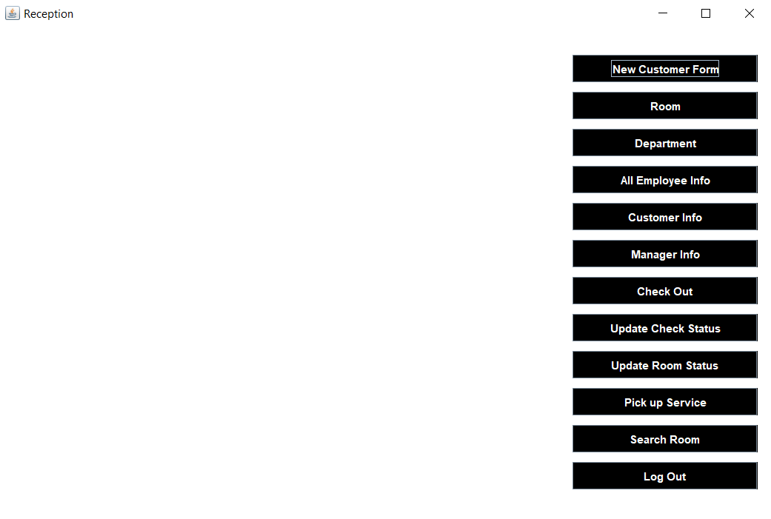
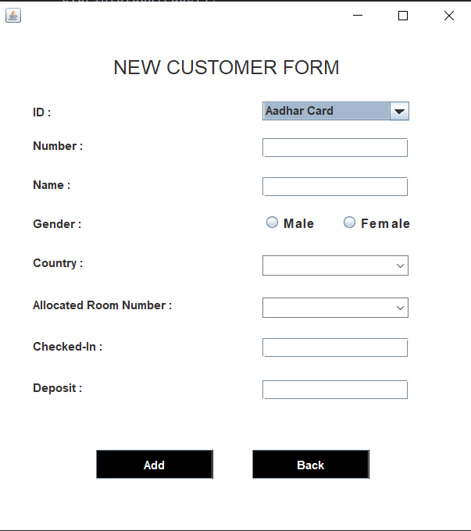

Slide 7
Thank You

